Slide 1

Data Science
Data Science
Data Analysis
Presented by :
DAABOUL Abdallah
Data Mining
Data will talk to you
if you want to listen "
JIM BERGESON

Slide 2

Introduction

Slide 3
04
03
R - RSTUDIO
02
PREDICTION METHODS
01
5’
REAL LIFE CASES
DATA SCIENCE
25’
15’
15’

Slide 4
04
03
R - RSTUDIO
02
PREDICTION METHODS
01
5’
REAL LIFE CASES
DATA SCIENCE
25’
15’
15’

Slide 5
What is Data Science
Data Science
Data Analysis
Inspecting, cleaning, transforming and modelling data
discovering useful information
informing conclusions and supporting decision-making
A
Machine Learning
Machine learning
Science of predictions
Automatizing decisions
Data Analysis
Data Mining
Extract information from a data set
Transform the information into a comprehensible structure for further use
Data Mining

Slide 6

Process of Data Science
Use Results
in Business
Simulate
Results
Visualize
Results
Model Data
Explore Data
Business
Application
Get Data

Slide 7
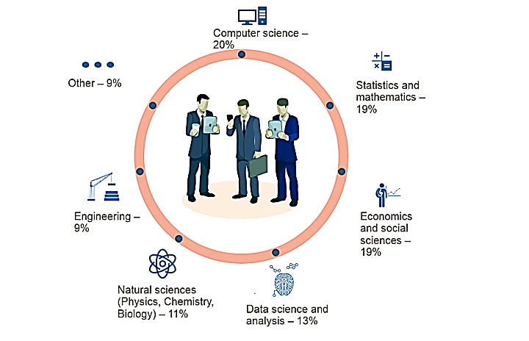
Data Scientists Background
https://www.datascience.com/blog/data-scientist-skills

Slide 8
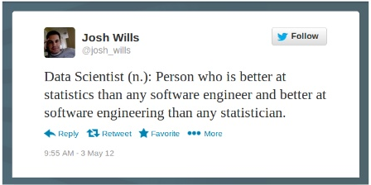

Data Science Venn Diagram
Drew Conway
2010
Model fitting
Data Preparation
Experimental Design
SQL
Data governance
Statistical Packages
Make it actionable
Understand Customers
Define metrics that matter
Ask good questions

Slide 9
Data Scientists Kit
Mathematics
Statistical Analysis
Linear Algebra
(Matrix Factorization)
Distribution
(Binomial, Poisson…)
Calculus
(Integrals, Derivatives…)
Summary Statistics
(Mean, Variance …)
Graph Theory
Hypothesis Testing
Probability
Combinatorics
Visualizations

Slide 10
Data Scientists Kit
Software
Engineering
Machine Learning
Supervised
(SVM, Random Forest)
Algorithms & Data Structures
Unsupervised
(K-means,LDA)
Data Visualization
Natural Language Processing (NLP)
Data Munging / Rangling
Model Comparison
Java / R / Python

Slide 11








Sectors
Sports
Technology
Telecom
Healthcare
Internet
Industry
Finance
Energy

Slide 12
04
03
R - RSTUDIO
02
PREDICTION METHODS
01
5’
REAL LIFE CASES
DATA SCIENCE
25’
15’
15’

Slide 13
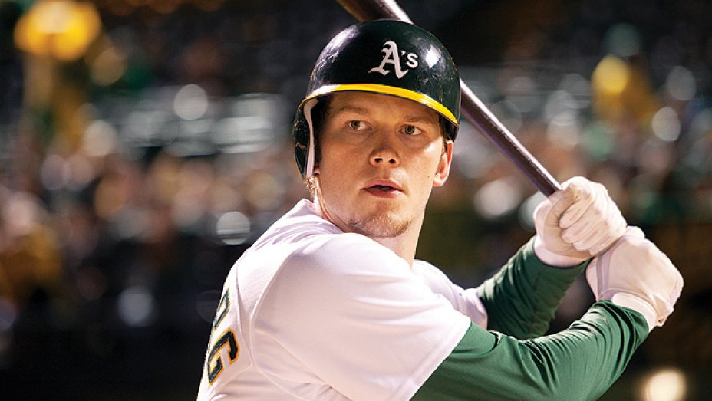
Moneyball: The Art of Winning an Unfair Game

Slide 14
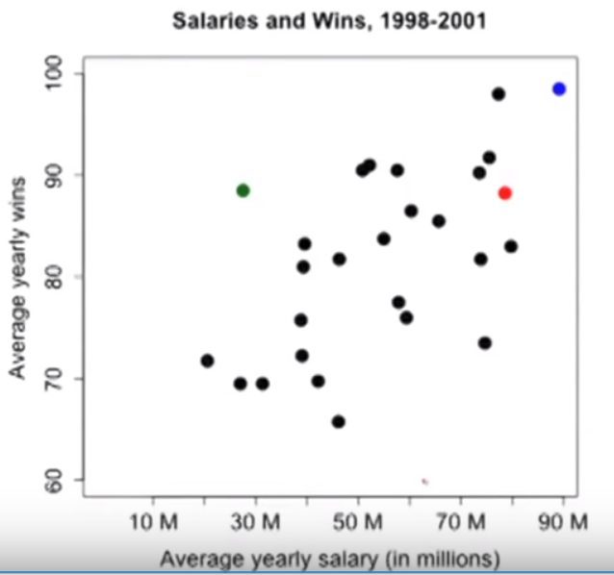
Moneyball
Rich Teams can afford the all-stars players
How do the poor teams compete?

Slide 15
Moneyball
NY
Auckland A’s
RedSox
RedSox Budget = 2.7 * AS Budget
RedSox wins = AS Wins
30M
80M

Slide 16
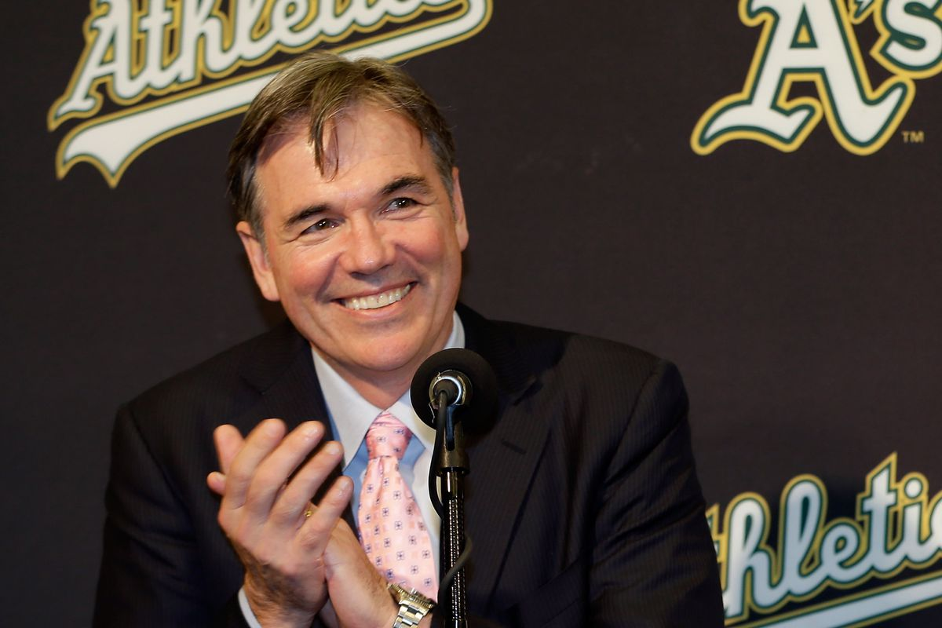
How did they succeed ?
Billy Beane (GM) succeeded in using analytics
Hired Paul DePodesta (Harvard graduate) as his assistant
Believed in statistics while everyone believed in scouting, and searching for athletic players with high speed
With the help of analytics, his assistant and him found the undervalued skills.
Bought low price players with high undervalued stats

Slide 17

eHarmony – Analytics can “spread love”

Slide 18
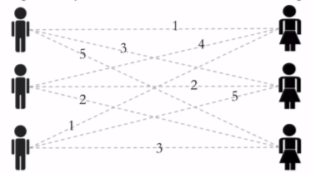
How to make couples
Suppose we have three men and three women
Compatibility scores between 1 and 5 for all pairs
We solve this problem using integer optimization

Slide 19
How to make couples
W_{i,j} : Compatibility
X_{i,j} : Whether I and j are together
1 if yes , 0 if not
We want to maximize our object: ∑ ∑ W_{i,j} * X_{i,j} = W_{1,1} * X_{1,1} + W_{1,2} * X_{1,2} + … + W_{n,n} * X_{n,}

Slide 20
How to make couples
Our constraints
Each man should match one woman: X_{1,1} + X_{1,2} + X_{1,3} = 1
X_{2,1} + X_{2,2} + X_{2,3} = 1
X_{3,1} + X_{3,2} + X_{3,3} = 1
Each woman should match oneman: X_{1,1} + X_{2,1} + X_{3,1} = 1
X_{1,2} + X_{2,2} + X_{3,2} = 1
X_{1,3} + X_{2,3} + X_{3,3} = 1

Slide 21
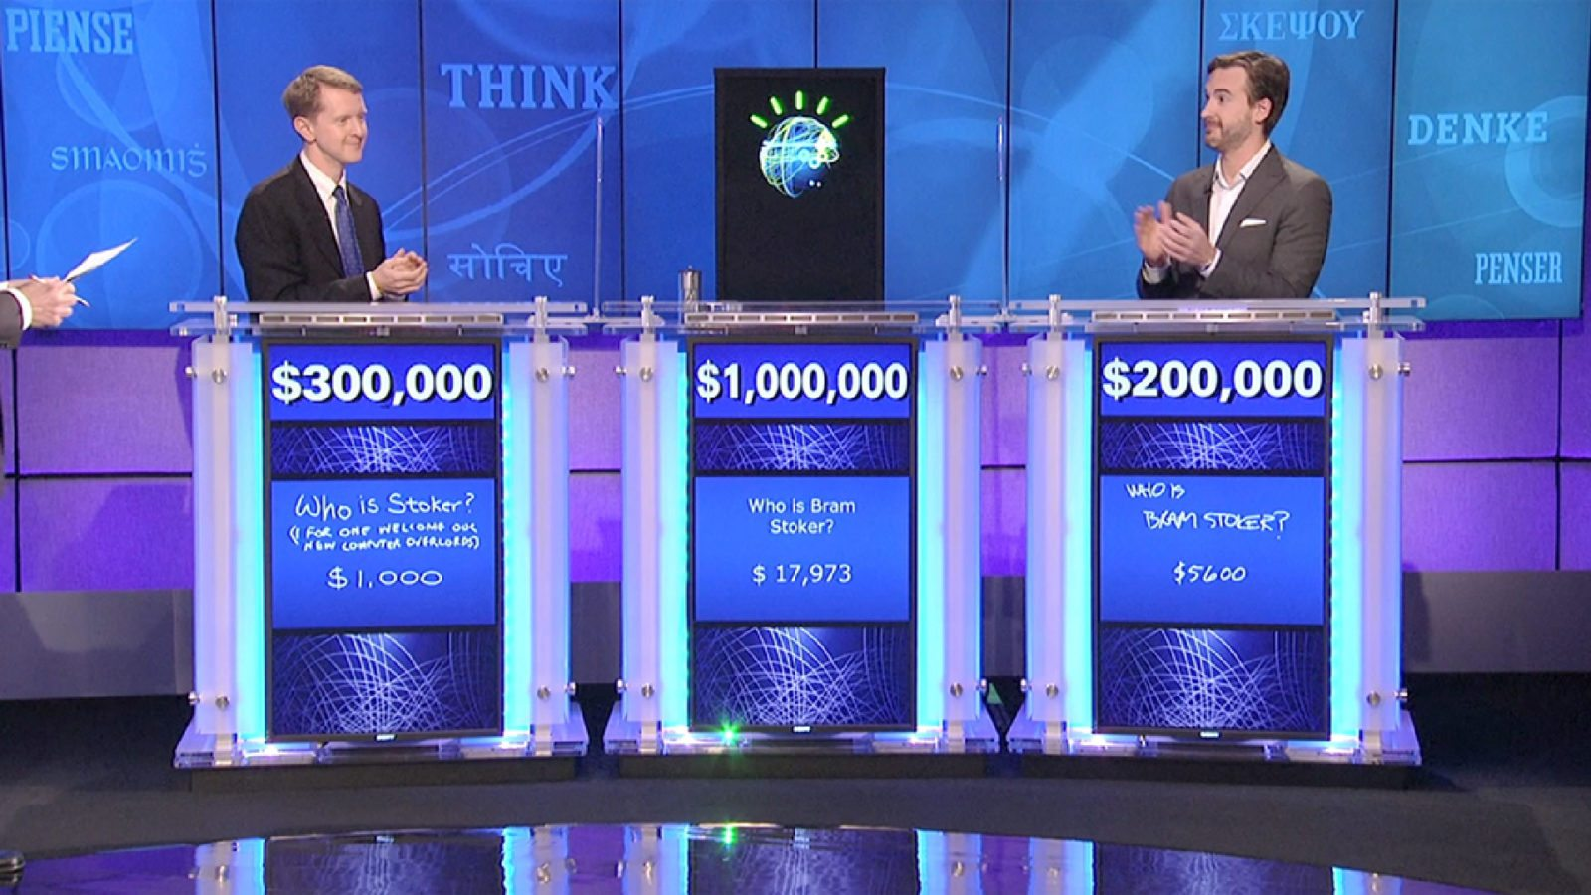
IBM Watson – The champ is here

Slide 22

IBM Watson
Recieves Data as text
Question Analysis
What question am I looking for?
Contains:
Enceclopedias
Wikipedia downloaded pages
Magazines …
Hypothesis Generation
Searches possible answers
Scoring Hypothesis
Compute confidence levels
Parser :
Recognizes type of words
Lexicon:
Describes relations between words
Final Ranking
Look for highly supported answer`

Slide 23
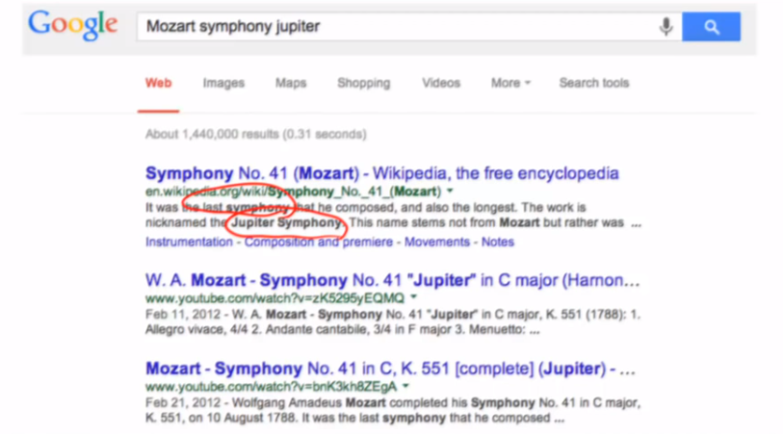
Example
Mozart’s last and perhaps most powerful symphony shares its name with this planet ‘’
Find the LAT : Planet
Find candidates : Mercury, Earth, Jupiter etc..
Scoring candidates :
Searches for candidates in storage and find its frequency
-Mozart’s last and perhaps most powerful symphony shares its name with Jupiter‘’
Uses logistic regression based on scores to determine if the answer is correct or not
(after merging similar answers – Lajoconde or monaliza- refers to the same answer)
Searches for most common answer, and the more logic one.

Slide 24
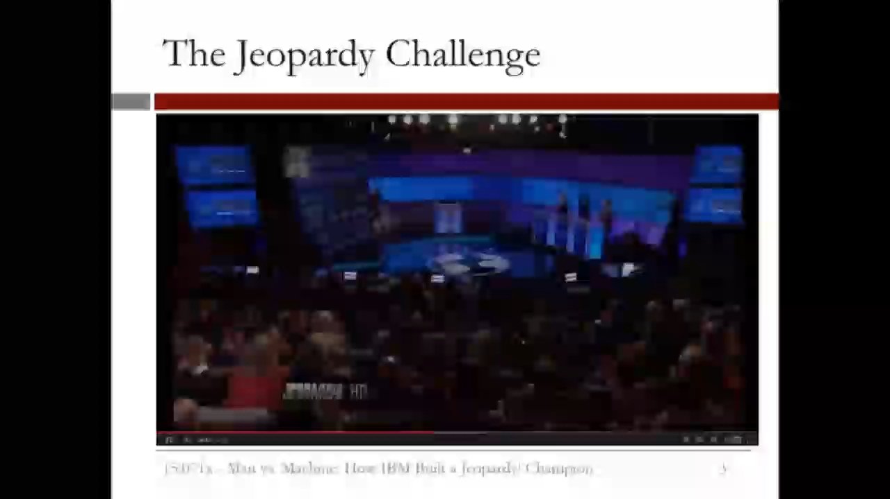

Slide 25
04
03
R - RSTUDIO
02
PREDICTION METHODS
01
5’
REAL LIFE CASES
DATA SCIENCE
25’
15’
15’

Slide 26
Linear Regression
y
dependent
variable
(output)
Predict the value of one variable (dependent variable) on the basis of others variables (indep. variable)
β0
Determine the strength of the relationship between one DV and a series of other changing variables(Indep)
x – independent variable (input)
The main idea is to minimize the sum of squared errors
SSE : ∑ (residue_{i})² = ∑ (predicted_{i} – actual_{i})²
y
R squared: R²= 1 – SSE / SST

Slide 27
Example LR
Let’s concider these three points
Is a line joining two of the tree points the best fit ?
Case 1 :
Case 2 :
Optimal Case:
7
7
7
3
5
5
3
SSE = 49
SSE = 25
SSE = 18

Slide 28
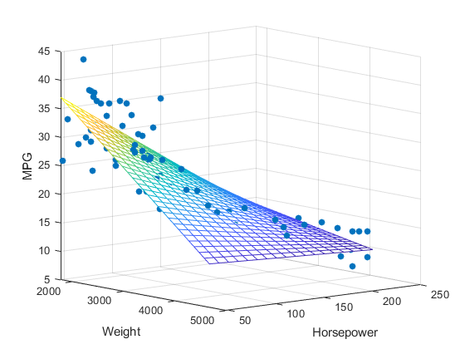

Multiple Linear Regression
Y = β₀ + β₁X₁ + β₂X₂ + ... + β_{k}X_{k}
β_{i} > 0 : Y and β_{i} are positevely related
β_{i} < 0 : Y and β_{i} are negatively related
It is unnecessary to use correlated variables as independent variables in our model.
This can reduce the accuracy of our model and can cause ovefitting

Slide 29
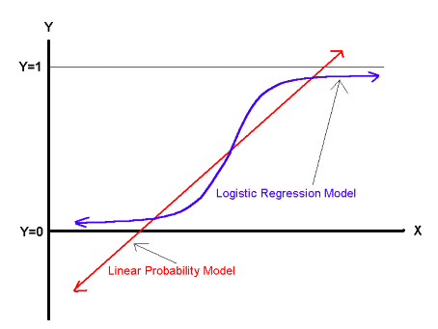

Binary Logistic Regression
Binomial output : 1 / 0
Ex : whether an email is a spam or not
P(Y = 1) = $\frac{\text{1}}{\text{1 + }\text{exp}\text{( − (} \text{β}\text{0}\text{+} \text{β}\text{1}\text{X}\text{1}\text{+…+}\text{β}\text{p}\text{X}\text{p} \text{))} }$
Select a threshold value t.
If P(xi) >= t → Yi = 1
else Yi = 0
So How To choose our threshold ?

Slide 30
Confusion Matrix
 | Predicted Value is False | Predicted Value is True
Actual Value is FALSE | TN (True Negative) | FP ( False Positive)
Actual Value is TRUE | FN ( False Negative) | TP ( True Positive)
Accuracy = ( TN+TP ) / (TN+TP+FN+FP)
Sensitivity = TP/(TP + FN) [When it’s actually yes, how often does it predict yes?]
Specificity = TN/(TN + FP) [When it’s actually no, how often does it predict no??]

Slide 31
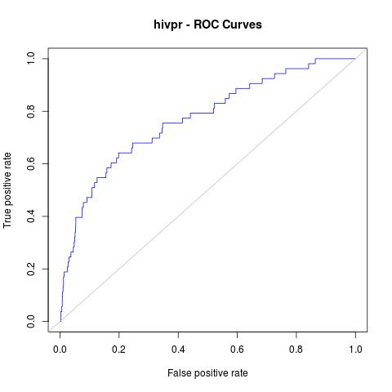



Threshold’s choice
t=0
Sensitivity
Specificity
t=1
AUC : Area under the curve
→ Predictions are good
I want high Specificity , thus I will go with a high treshold
I want high Sensitivity, thus I will go with a low treshold

Slide 32









Classification and regression trees CART
Is Human ?
IS A GAMER ?
Y
N
Age<20
N
Y
Is Male?
Y
N

Slide 33
Splits in CART
Split 1
23
Predict RED
Predict BLUE
21
Split 2
19
Independent 1
17
Predict RED
Predict BLUE
15
Independent 1
Split 3

Slide 34
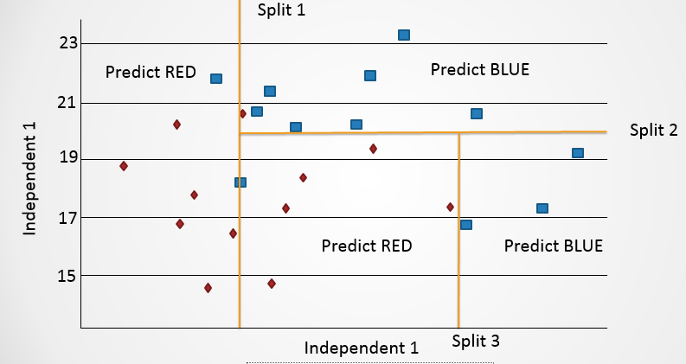
Splits in CART
X < 60
RED
Y < 20
X<85
BLUE
RED
BLUE

Slide 35
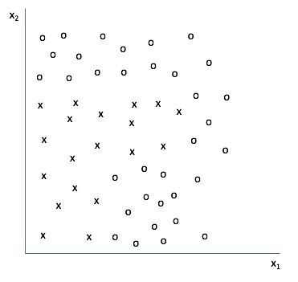
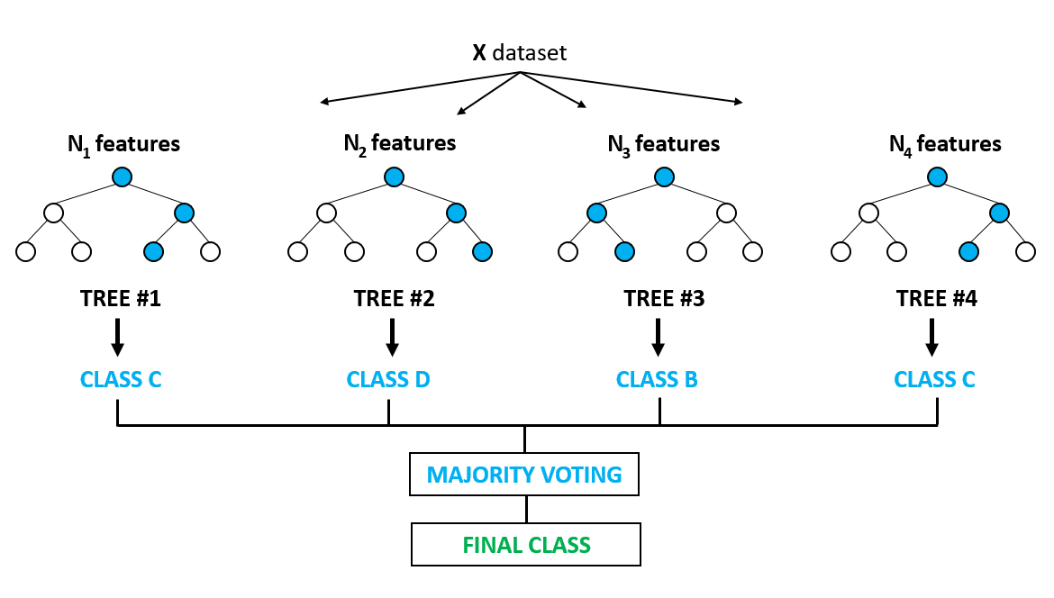
If you are curious
Optimal Trees
Random Forest

Slide 36
04
03
R - RSTUDIO
02
PREDICTION METHODS
01
5’
REAL LIFE CASES
DATA SCIENCE
25’
15’
15’

Slide 37


R
Programming language
Used for statistical computing and graphics
Created in the University of Auckland
Named after the first names of the 2 R authors Ross Ihaka and Robert Gentleman
R has more than 10,000 packages

Slide 38

Advantages of R

Slide 39


RStudio
Free and Open Source
Founded by JJ Allaire
Integrated development environment for R
8 years of age

Slide 40
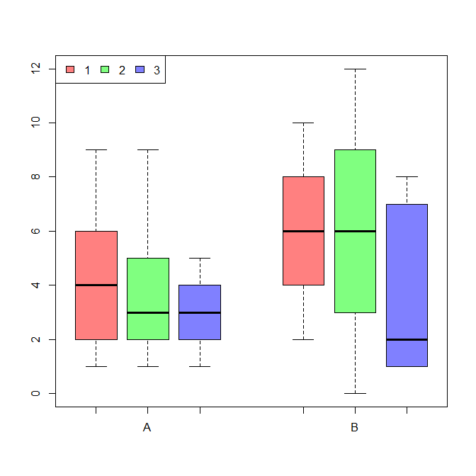
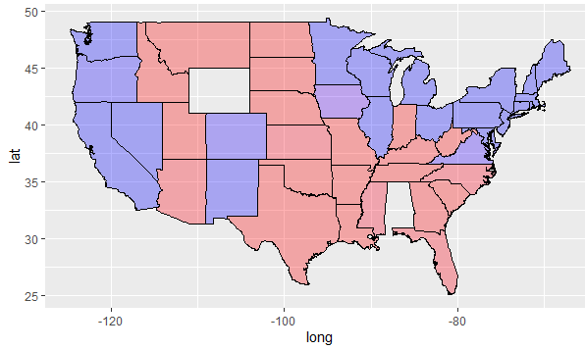
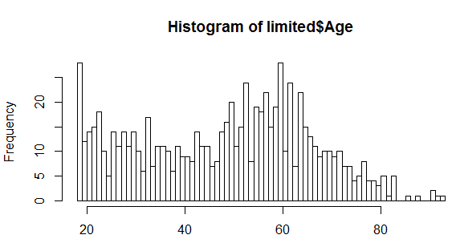
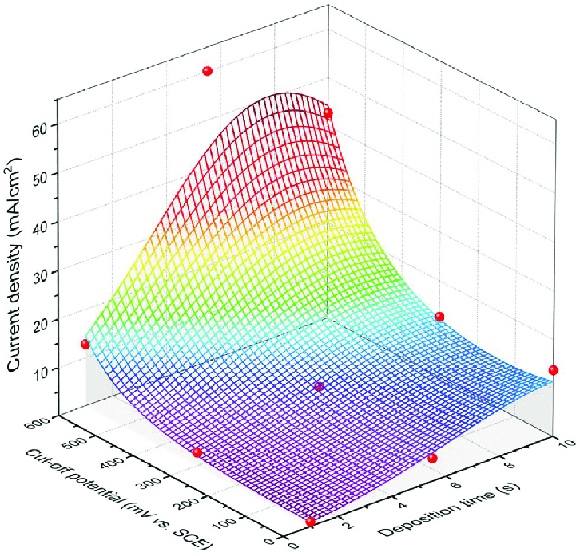
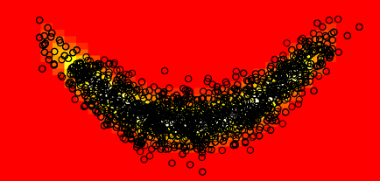
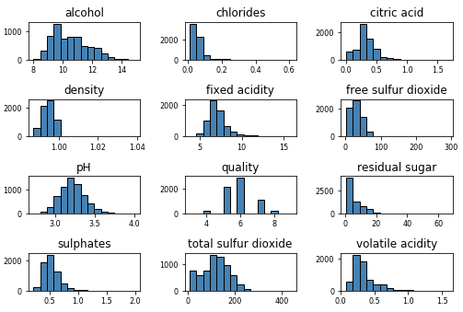
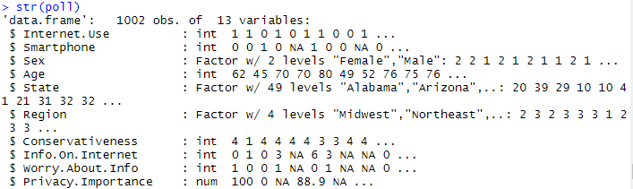
Examples On R
And many more …..
Heatmaps
Box Plots
Histograms and Probas
3D
Data Frames

Slide 41
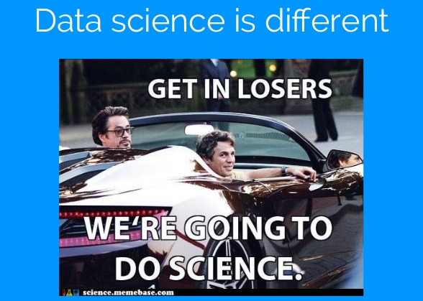
THANK YOU FOR LISTENING !!

